Slide 1






Foundations of
Quantum Computing
(QIS 301)
Dave Biersach
Brookhaven National Laboratory
dbiersach@bnl.gov
Session 09
Statistics

Slide 2
Session Goals
Analyze Hero ability scores in role-playing games by calculating the mean, variance, and standard deviation of a sequence of random numbers
Understand the motivation for Bessel’s correction to the biased sample variance to develop a better estimate of the population variance
Develop a computational mathematics experiment that uncovers a magic number hidden in all uniform random number distributions
Investigate if a Normal Distribution can be generated from a Uniform Distribution using a Pachinko game

Slide 3

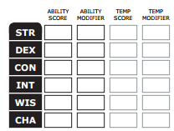
Generating Hero Ability Values
In most role-playing games, heroes have abilities such as strength, dexterity, intelligence, charism, etc.
Initial abilities are often measured in ranges like 3 – 18
At the beginning of the game, players roll dice to determine the initial values for each ability
The higher the value, the more likely the player will succeed while adventuring

Slide 4
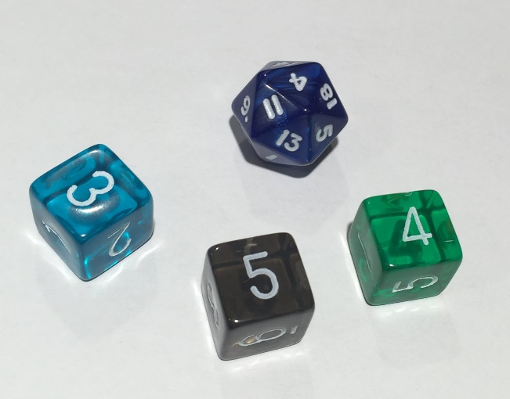
Generating Hero Ability Values
Two ways of rolling for initial abilities between 3 and 18
Roll a 20-sided die just once (1d20), but reroll if face value is 1, 2, 19, or 20
Roll a 6-sided die three times (3d6), summing the value of each roll
Using the 1d20 method is faster than 3d6, especially when having to roll for six separate abilities
17
11
15
5
7
3

Slide 5
Generating Hero Ability Values
Two ways of rolling for initial abilities between 3 and 18:
Roll a 20-sided die just once (1d20), but reroll if face value is 1, 2, 19, or 20
Roll a 6-sided die three times (3d6), summing the value of each roll
Which method would you want to use? Why?
17
11
15
5
7
3

Slide 6
Mean vs. Variance
Imagine two different classes take the same test
1st period students score between 50 and 100 with μ = 75
2nd period students score between 70 and 80 with μ = 75
Variance ${(σ}^{2})$ is the average “distance” between each number in a set and the mean $\left(μ\right)$ of that set
1st period students have a greater variance in scores than 2nd period
Variance is a measure of central tendency – on average how close around the mean do all the numbers fall?
For every data point, we sum the square of the difference between the number and the mean. Then we divide that sum by the total number of data points

Slide 7
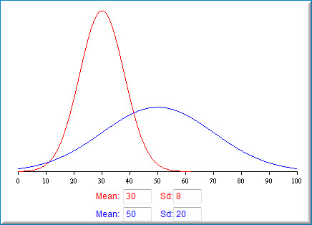
Mean vs. Standard Deviation
Note: Standard Deviation (σ) is the square root of the Variance (σ²)

Slide 8
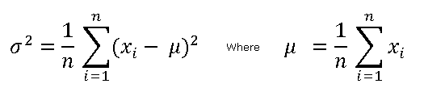
Mean, Variance, Standard Deviation
Mean

Slide 9
Mean, Variance, Standard Deviation
Mean
$$x=\left\{2, 9, 11, 5, 6\right\}∴n=5$$
$$\sum_{i=1}^{n}{x_{i}}=\left(2+9+11+5+6\right)=33$$
$$μ=\frac{33}{5}=6.6$$

Slide 10
Mean, Variance, Standard Deviation
Variance
Mean
$$x=\left\{2, 9, 11, 5, 6\right\}∴n=5, μ=6.6$$
$$\sum_{i=1}^{n}{{{(x}_{i}−μ)}^{2}}={(2−6.6)}^{2}+{(9−6.6)}^{2}+{(11−6.6)}^{2}+…=49.2$$
$$σ^{2}=\frac{49.2}{5}=9.84$$

Slide 11
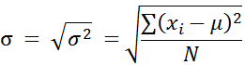
Mean, Variance, Standard Deviation
Variance
Mean
$$x=\{2, 9, 11, 5, 6\}$$
Standard Deviation
$$σ^{2}=9.84$$
$$σ=\sqrt{9.84}≅3.13$$

Slide 12
Determine Which Roll Method is Best
Update a program to generate 1,000,000 hero ability scores, comparing the mean and standard deviation of the 1d20 versus the 3d6 dice roll methods
Write the missing code to correctly calculate the standard deviation in a series of 1d20 rolls
Which dice roll method would you want to use to generate your hero’s abilities – any why?

Slide 13
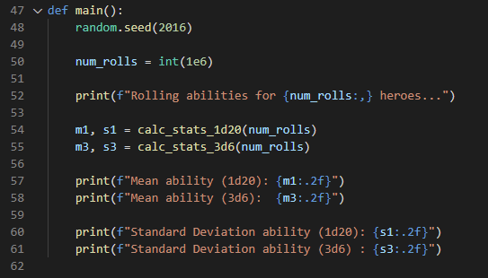
Open Lab 1 – Hero Abilities
①
②
③
④
⑤
⑥

Slide 14
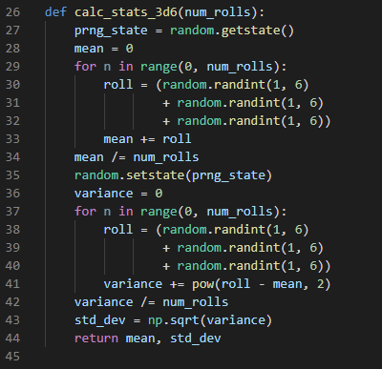
View hero_abilities.py
①
②
③
④
⑤
⑥
⑦

Slide 15
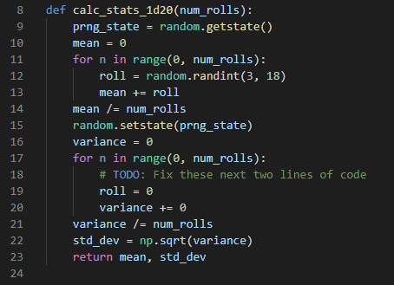

Edit hero_abilities.py

Slide 16
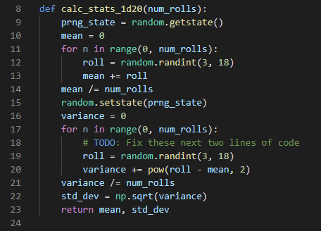
Edit hero_abilities.py

Slide 17
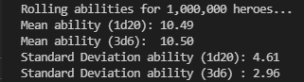
Run hero_abilities.py
Which roll type will most likely give you the highest average score across all abilities?

Slide 18
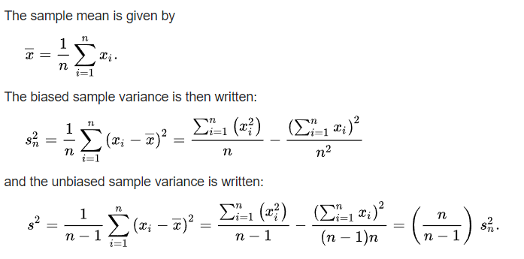
Bessel’s Correction
BSV

Slide 19
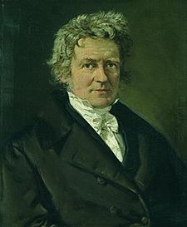
Bessel’s Correction
What is the difference between population vs. sample variance?
Fredrich Wilhelm Bessel (1784-1846)
BSV
UBSV
Bessel’s Correction
(UBSV)
Does subtracting 1 from n really
make any difference at all?

Slide 20
Bessel's Correction
Write an experimental simulation in Python that generates 19 sets containing 7000 random natural numbers < 1000
Calculate the full population variance (PV) for each set
For set n, create 20,000 random sample sets of size n+1 taken from the values in set n. Then find the mean biased sample variance (BSV) for all 20,000 sample sets
For set #1, create 20,000 random sample sets of size 2. Then find the mean BSV for all 20,000 two-sample sets of set #1
For set #2, create 20,000 random sample sets of size 3. Then find the mean BSV for all 20,000 three-sample sets of set #2

Slide 21
Bessel's Correction
Display a table with one row for each of the 19 random sets. The columns should show (for that set) the sample size, the mean BSV, the PV, and ratio of BSV/PV
Row #1 represents the statistics if you only created a sample size of two random samples from set #1
Row #2 represents the statistics if you only created a sample size of three random samples from set #2
Plot the ratio of BSV/PV for increasing sample sizes from 2 to 20, and superimpose a plot of the hyperbola (n-1)/n
How does the graph of BSV/PV compare to that hyperbola?
We can rarely calculate the true (full) PV – but can we reliably use the BSV with small sample sets – to estimate the actual PV?

Slide 22
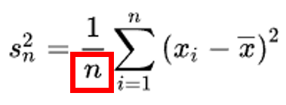
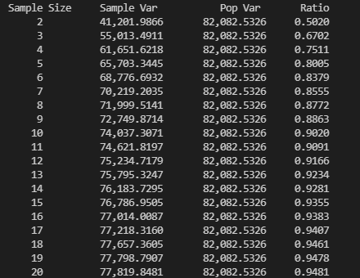
Run Bessel_correction.py
Biased (uncorrected) sample variance (BSV)
Actual full population variance (PV)
BSV / PV
19 sets of 7000 random natural numbers < 1000

Slide 23
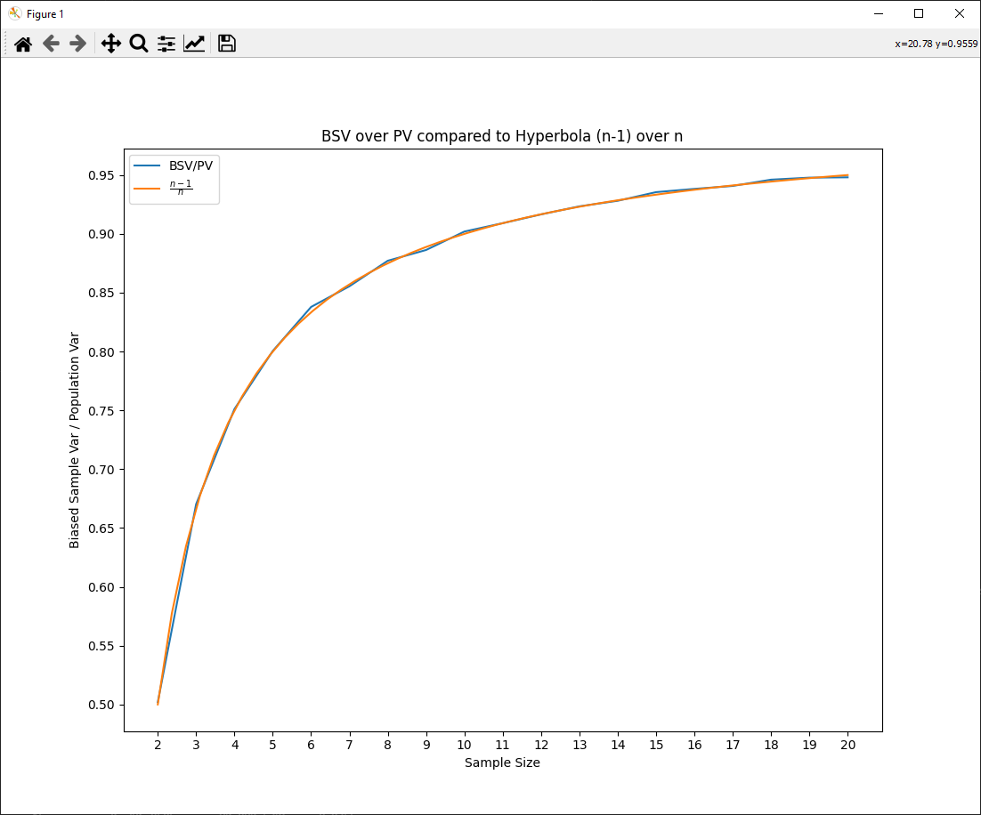
Bessel's Correction
The ratio of BSV/PV tracks very closely to the hyperbola y=(n-1)/n

Slide 24
Bessel's Correction
At small sample sizes, the BSV (uncorrected) is a poor estimator for the true PV
(B)iased = BAD!

Slide 25
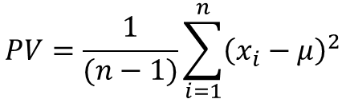
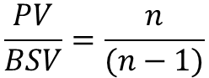
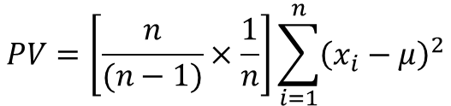
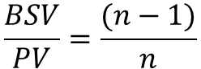
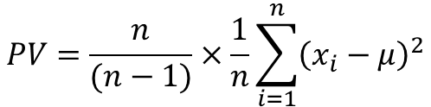
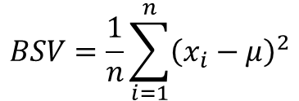
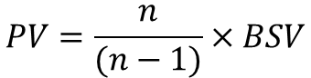
Bessel's Correction
$$\frac{BSV}{PV}=\frac{(n−1)}{n}$$
$$PV=\frac{n}{(n−1)}×\frac{1}{n}\sum_{i=1}^{n}{{\left(x_{i}−μ\right)}^{2}}$$
$$\frac{PV}{BSV}=\frac{n}{(n−1)}$$
$$PV=\left[\frac{n}{(n−1)}×\frac{1}{n}\right]\sum_{i=1}^{n}{{\left(x_{i}−μ\right)}^{2}}$$
$$PV=\frac{n}{(n−1)}×BSV$$
$$PV=\frac{1}{(n−1)}\sum_{i=1}^{n}{{\left(x_{i}−μ\right)}^{2}}$$
$$BSV=\frac{1}{n}\sum_{i=1}^{n}{{\left(x_{i}−μ\right)}^{2}}$$
UBSV
Bessel’s Correction
Subtracting 1 from n really does make a difference.
Even if we only can get small samples, the UBSV can still give a good estimate of the full population variance!

Slide 26
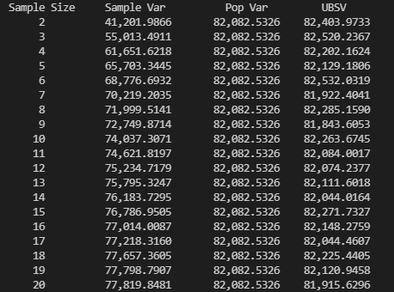
Run Bessel_correction.py AGAIN
Even with small sample sizes, the UBSV can give a good estimate of the full population variance!
Consider here we are sampling only 0.24% (17/7000) of the population!

Slide 27
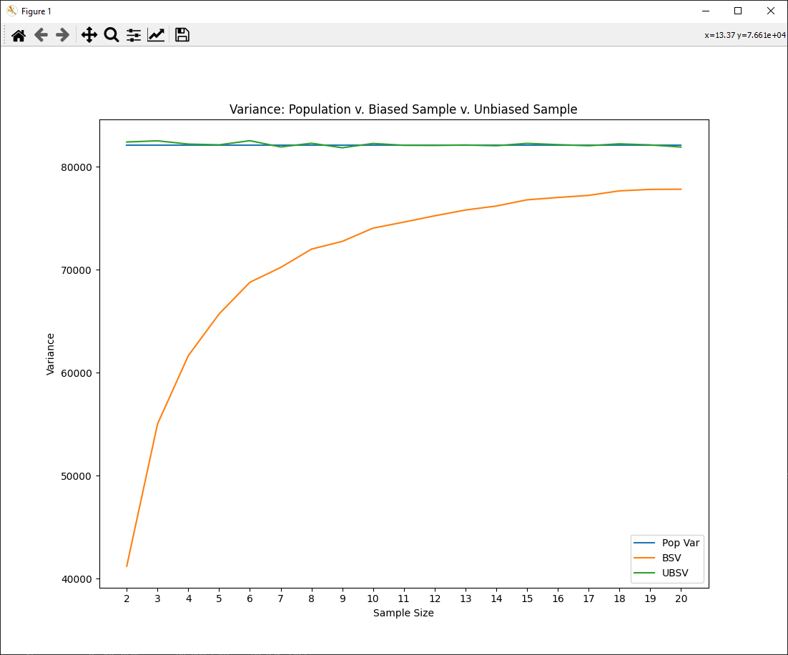
Bessel's Correction
At small sample sizes, the BSV (uncorrected) is a poor estimator for the true PV

Slide 28
Bessel's Correction
The UBSV tracks very closely to the true PV

Slide 29
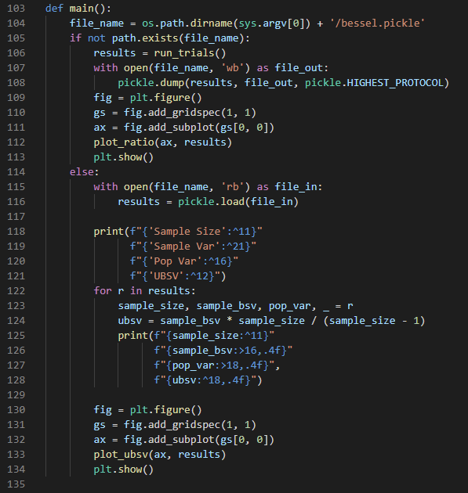
View bessel_correction.py
①
②
③

Slide 30
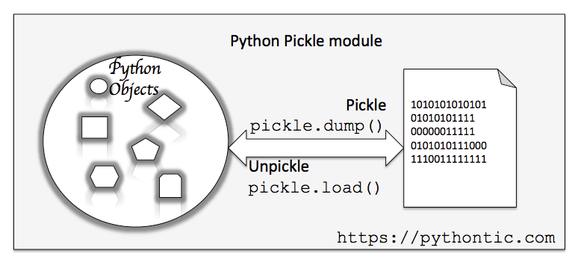
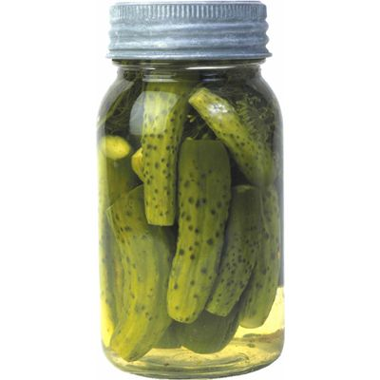
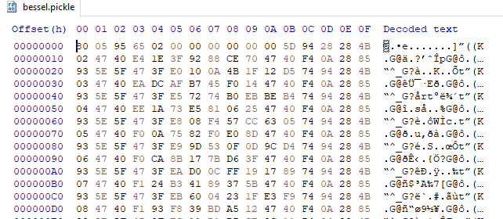
Python Pickle

Slide 31
View bessel_correction.py
①
②
③
④
⑤
⑥
⑦

Slide 32
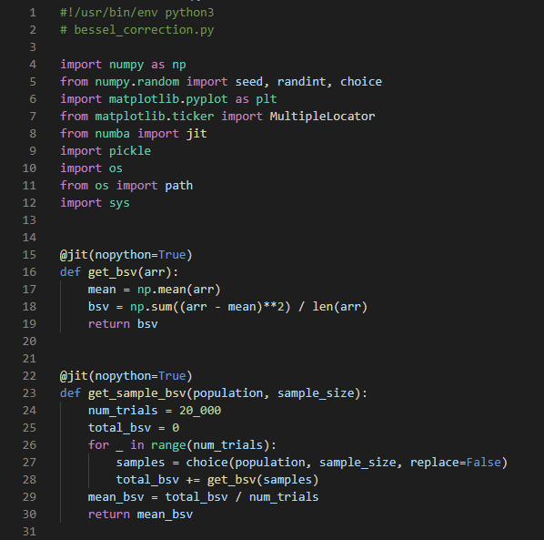
View bessel_correction.py
①
②
③
NumPy can do vectorized operations on all array elements
④
⑤
⑥
⑦

Slide 33
Variance of Uniform Distributions
Given an existing program that can:
Generate 15 sets of random size between 1 million & 2 million items
Within each set, every item is a random integer chosen within a range between a lower limit and an upper limit
The lower limit is a random number between 0 and 1000
The upper limit is 2x that set’s lower limit + another random number between 0 and 1000
Calculate the mean (μ) and variance (σ²) for each set's population
$$σ^{2}=\frac{1}{n}\sum_{i=i}^{n}{{\left(x_{i}−μ\right)}^{2} where μ=\frac{1}{n}\sum_{i=1}^{n}{x_{i}}}$$

Slide 34
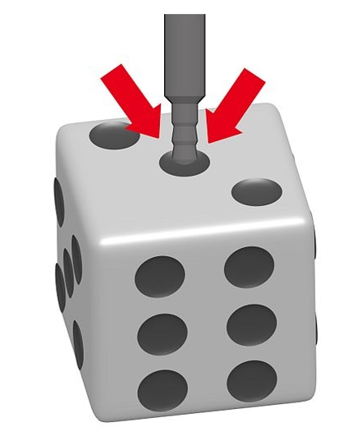
Variance of Uniform Distributions
Your assignment is to discover a magic number hidden in all uniform random number distributions
Calculate and display this “constant” for each set:
Is this number the same for ALL uniform distributions?
Can we use this value to test if dice are loaded?
magicNumber = $\frac{{(upperLimit − lowerLimit)}^{2}}{variance}$

Slide 35
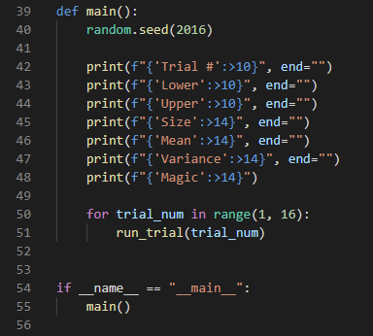
Open uniform_variance.py
③
④
⑤
⑥
⑦
①
②

Slide 36
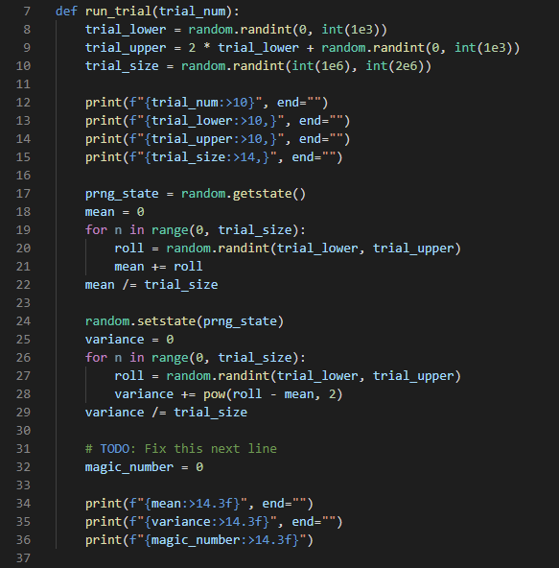
Edit uniform_variance.py
①
②
③
④
⑤
⑥
Fix this formula

Slide 37
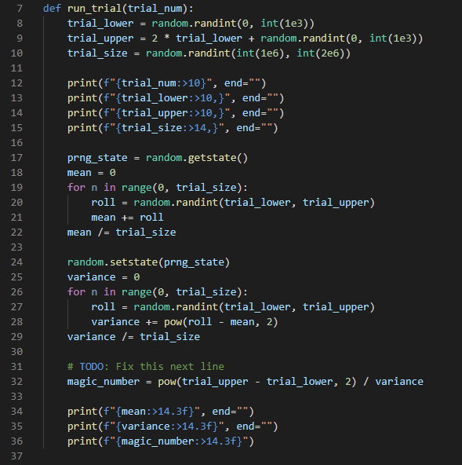
Edit uniform_variance.py

Slide 38
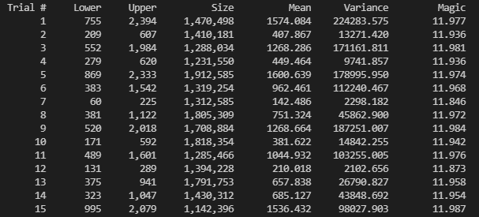
Run uniform_variance.py
Every set had a different lower and upper limit, size, mean, and variance… yet the magic number was $\sim 12$ for all of them!
Why would Mother Nature pick the value 12 for this magic number? What is so special about 12? Why not pick a nice even 10?
Boundless natural curiosity is what makes a good scientist…

Slide 39
Variance of Uniform Distributions
$$σ^{2}=\frac{1}{n}\sum_{i=i}^{n}{{\left(x_{i}−μ\right)}^{2} where μ=\frac{1}{n}\sum_{i=1}^{n}{x_{i}}}$$
The expected value $\left(𝔼\right)$
of a random variable $X$ is its mean value $\left(μ\right)$
Variance $\left(σ^{2}\right)$ is the mean difference squared between every $X$ and its $𝔼\left(X\right)$
$$𝔼\left(X\right)=μ=\frac{1}{n}\sum_{i=1}^{n}{x_{i}}$$
$σ^{2}=𝔼$ $\left[{\left(X−𝔼\left(X\right)\right)}^{2}\right]$
The expected value $\left(𝔼\right)$
returns a constant value
$$𝔼\left(X\right)=μ$$
$$𝔼\left(𝔼\left(X\right)\right)=𝔼\left(X\right)$$
The expected value $\left(𝔼\right)$
of a constant value returns that same value
$$𝔼\left(𝔼\left(𝔼\left(X\right)\right)\right)=𝔼\left(X\right)$$
$$𝔼\left(μ\right)=μ$$

Slide 40

Variance of Uniform Distributions
$$σ^{2}=\frac{1}{n}\sum_{i=i}^{n}{{\left(x_{i}−μ\right)}^{2} where μ=\frac{1}{n}\sum_{i=1}^{n}{x_{i}}}$$
$$μ=𝔼\left(X\right)=\frac{1}{n}\sum_{i=1}^{n}{x_{i}}$$
$σ^{2}=𝔼$ $\left[{\left(X−𝔼\left(X\right)\right)}^{2}\right]$
FOIL
$$σ^{2}=𝔼\left[X^{2}−2X𝔼\left(X\right)+{𝔼\left(X\right)}^{2}\right]$$
$σ^{2}=𝔼$ $\left[{\left(X−𝔼\left(X\right)\right)}^{2}\right]$
Note: $𝔼\left(x\right)$ is a distributive linear operator
$$𝔼\left(μ\right)=μ$$
$$σ^{2}=𝔼\left(X^{2}\right)−𝔼\left(2X𝔼\left(X\right)\right)+𝔼\left({𝔼\left(X\right)}^{2}\right)$$
$$𝔼\left(𝔼\left(X\right)\right)=𝔼\left(X\right)$$
$$σ^{2}=𝔼\left(X^{2}\right)−2𝔼\left(X\right)𝔼\left(X\right)+{𝔼\left(X\right)}^{2}$$
Faster because
only one subtraction is required!
$$σ^{2}=\left(\frac{1}{n}\sum_{i=1}^{n}{x_{i}^{2}}\right)−μ^{2}$$
$$σ^{2}=𝔼\left(X^{2}\right)−2{𝔼\left(X\right)}^{2}+{𝔼\left(X\right)}^{2}$$
$$σ^{2}=𝔼\left(X^{2}\right)−{𝔼\left(X\right)}^{2}$$
$$σ^{2}=𝔼\left(X^{2}\right)−μ^{2}$$

Slide 41
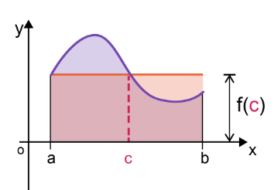
Variance of Uniform Distributions
$f\left(c\right)=$ the average value of the function
Mean Value Theorem (Integrals)
$${Area}_{red}={Area}_{curve}$$
$${Area}_{red}=f(c)×\left(b−a\right)$$
$${Area}_{curve}=\int_{a}^{b}{f\left(x\right)ⅆx}$$
$$f\left(c\right)×\left(b−a\right)=\int_{a}^{b}{f\left(x\right)ⅆx}$$
Random Variable (Uniform Distribution)
$$𝔼\left(X\right)=\frac{1}{n}\sum_{i=1}^{n}{x_{i}}$$
$$f\left(c\right)=\frac{1}{\left(b−a\right)}\int_{a}^{b}{f\left(x\right)ⅆx}$$
Discrete:
$$𝔼\left(X\right)=\frac{1}{\left(b−a\right)}\int_{a}^{b}{xⅆx}$$
$$f\left(c\right)=μ=𝔼\left(X\right)$$
Continuous:

Slide 42
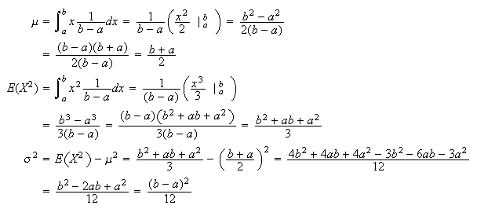

Variance of Uniform Distributions
$$𝔼\left(X\right)=\frac{1}{\left(b−a\right)}\int_{a}^{b}{xⅆx}$$
Moment Generating Function
$$𝔼\left(X^{2}\right)=\frac{1}{\left(b−a\right)}\int_{a}^{b}{x^{2}ⅆx}$$
$$σ^{2}=𝔼\left(X^{2}\right)−μ^{2}$$
$$\frac{\left(18+3\right)}{2}=10.5$$
Lab 1 Results

Slide 43
Variance of Uniform Distributions
$$𝔼\left(X\right)=\frac{1}{\left(b−a\right)}\int_{a}^{b}{xⅆx}$$
Moment Generating Function
$$𝔼\left(X^{2}\right)=\frac{1}{\left(b−a\right)}\int_{a}^{b}{x^{2}ⅆx}$$
$$σ^{2}=𝔼\left(X^{2}\right)−μ^{2}$$

Slide 44
Variance of Uniform Distributions
$$𝔼\left(X\right)=\frac{1}{\left(b−a\right)}\int_{a}^{b}{xⅆx}$$
Moment Generating Function
$$𝔼\left(X^{2}\right)=\frac{1}{\left(b−a\right)}\int_{a}^{b}{x^{2}ⅆx}$$
$$σ^{2}=𝔼\left(X^{2}\right)−μ^{2}$$
$$12= \frac{{(upperLimit − lowerLimit)}^{2}}{variance}$$

Slide 45
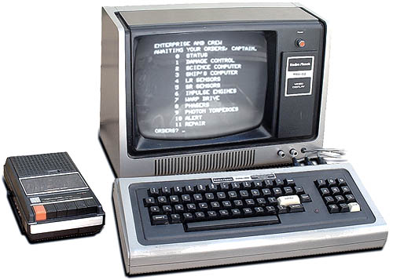
Simulating a Normal Distribution
Until recently, most computer languages only provided a uniform pseudo-random number generator
Growing up I had heard of a bell curve, and I understood the rationale for curving test scores
However, I could not create a normal distribution using my 1978 vintage TRS-80 computer using Bill Gate’s first BASIC language interpreter
… or could I?

Slide 46
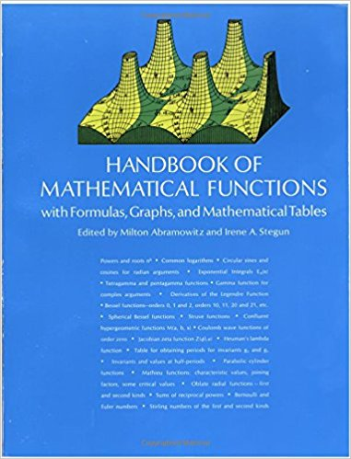
Simulating a Normal Distribution
There are indeed several ways to turn a uniform distribution into a normal distribution
Developing an accurate functional approximation to a normal curve requires advanced mathematics
Consider the following code by Abramowitz & Stegun…

Slide 47
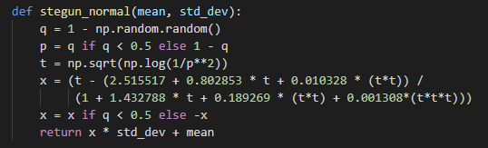
Simulating a Normal Distribution
This was neat but I did not understand it at all!
Where did all those magic numbers come from?
I wanted to base my approach on something tangible

Slide 48
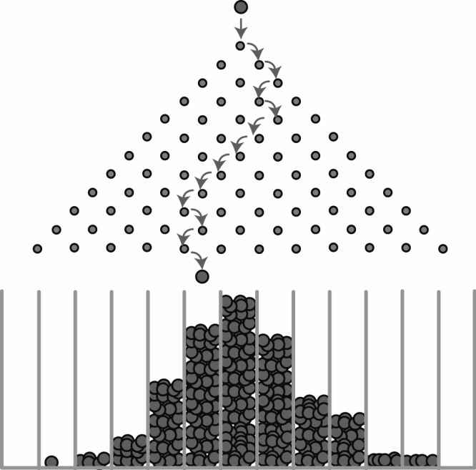
The Pachinko Distribution

Slide 49
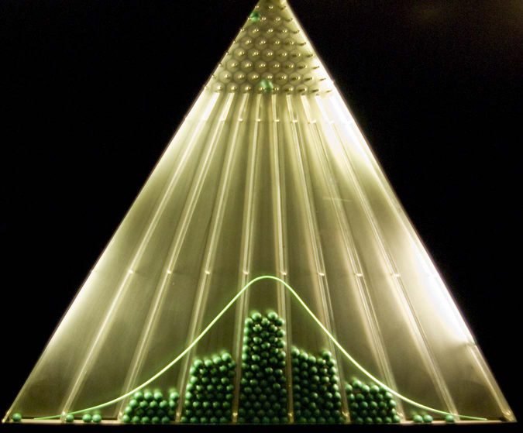
The Pachinko Distribution

Slide 50
Simulating a Normal Distribution
We can simulate dropping balls down a Pachinko machine where at each level a ball can move one step to left or right
If we drop enough balls through enough levels, and we accumulate the count of balls at each slot at the bottom, then we should be able to simulate a normal distribution
We will visually (qualitatively) judge how well this method approximates a normal distribution
However, there are many statistical (quantitative) methods to calculate if an algorithm emits a distribution that has a reasonable deviation from the perfect (pure) normal distribution
If the discrepancies are statistically significant, then we cannot trust that our algorithm is producing a “good enough” results to use in scientific simulations

Slide 51
Simulating a Pachinko Machine
6 levels
Slot #:

Slide 52
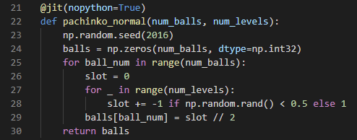
Simulating a Pachinko Machine
6 levels
Slot #:
-3
-2
-1
0
1
2
3
①
②
③
④

Slide 53
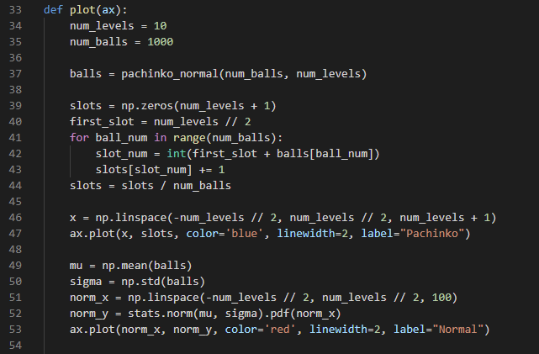
View pachinko_normal.py
①
②
③
④
⑤
⑥
⑦

Slide 54
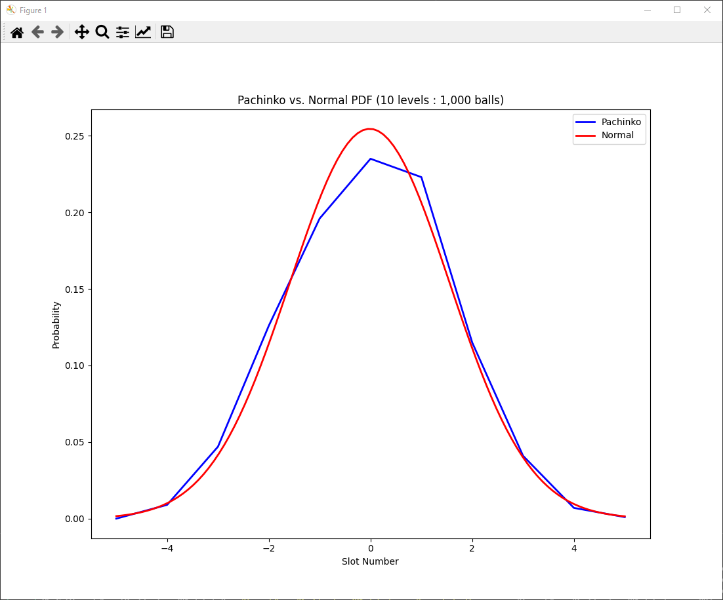
Run pachinko_normal.py
These model parameters do not generate a "good" normal distribution

Slide 55
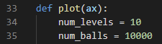
Edit pachinko_normal.py
Maybe if we increase by 10x the number of pachinko balls dropped through the machine?

Slide 56
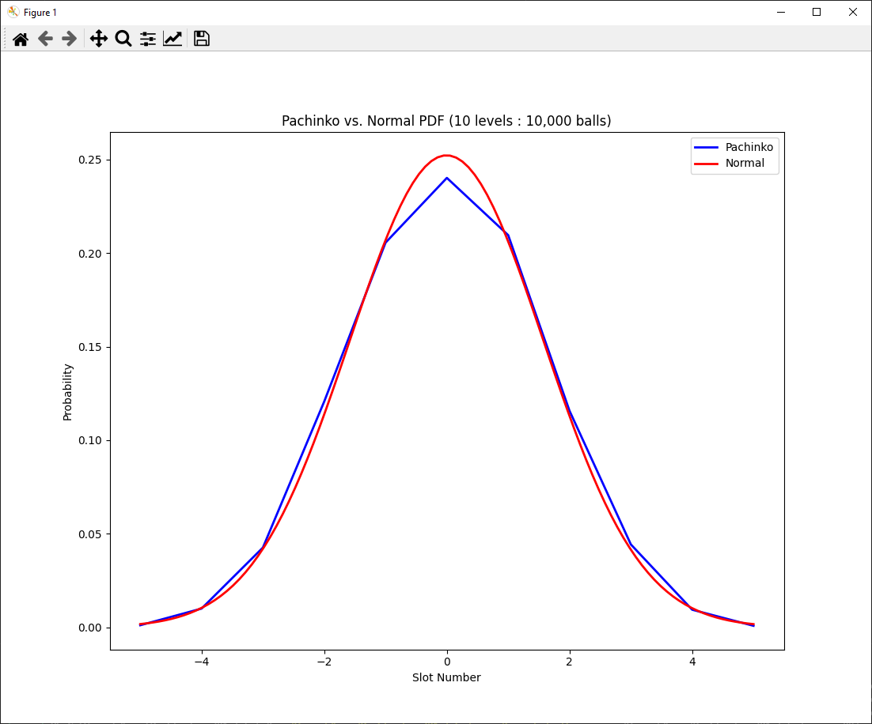
Run pachinko_normal.py
Better, but there are still significant gaps between observed vs. expected values

Slide 57
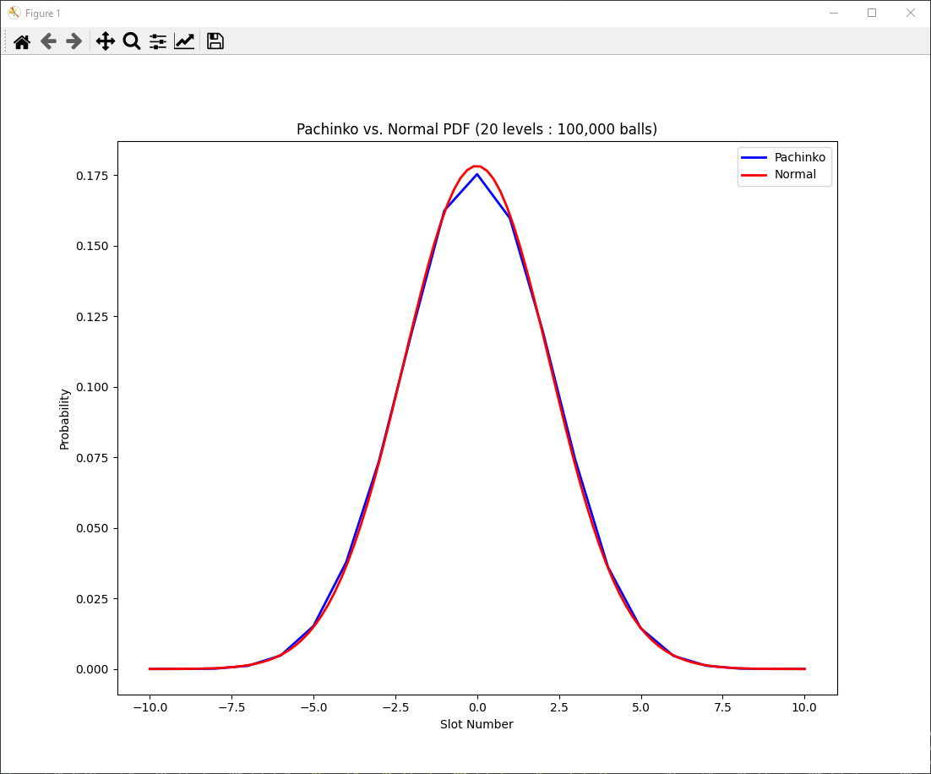
Edit & Run pachinko_normal.py

Slide 58
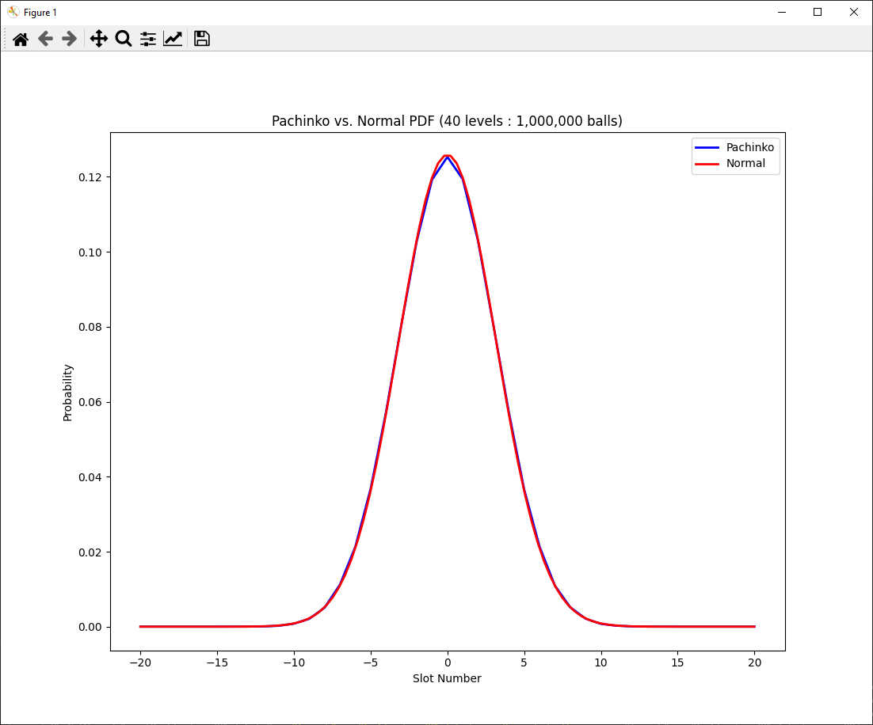
Edit & Run pachinko_normal.py
Still getting some gaps in the slots with the highest probability

Slide 59
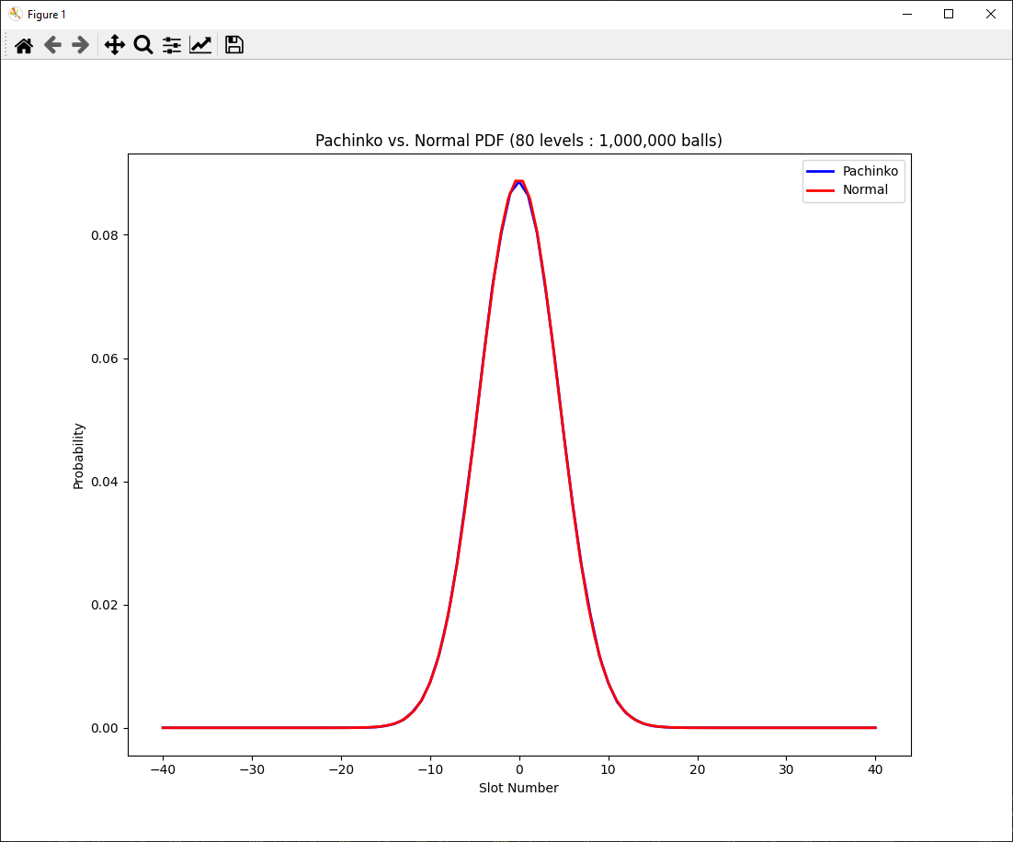
Edit & Run pachinko_normal.py
Finally, around 80 million bounces, we start to faithfully approximate a normal distribution

Slide 60
Simulating a Normal Distribution
Can the Pachinko model accurately mimic a normal distribution? Yes! ...but only under the right circumstances
It turns out that it is not just the number of balls that are used in the experiment that matters, but also the number of levels in the simulated Pachinko board
The levels affects how wide (displacement from the center slot) a ball can fall left or right from the topmost (first) pin
We must use enough levels (therefore creating sufficient width in the last level) to ensure the balls spread out during their fall to occupy those bottom slots that represent the higher sigma values of a normal distribution

Slide 61
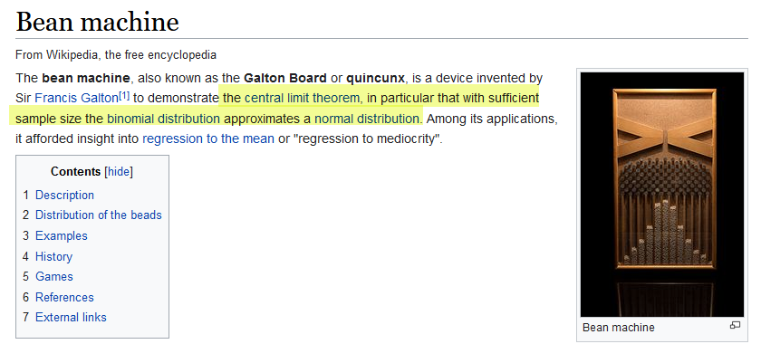
Simulating a Normal Distribution
https://en.wikipedia.org/wiki/Bean_machine

Slide 62


Central Limit Theorem

Slide 63
Simulating a Normal Distribution
Python's SciPy.stats uses code from Abramowitz & Stegun, as only one uniform random number call is required vs. my Pachinko method!

Slide 64

Testing for Gaussian Distribution
The SciPy package provides several quantitative normal tests
Shapiro-Wilk : Can be sensitive to sample size
D'Agostino K² : considers skew (asymmetry) and kurtosis (tail density)
Anderson-Darling : improved Kolmogorov-Smirnov test
Most statistical tests return two values
The Statistic : Compare this value to the critical values associated with the intended distribution
The "p-Value" : Used to interpret the test – If$p≤α$ then we reject the null hypothesis $H_{0}$ meaning the sample data is not Gaussian

Slide 65
Understanding Probability
The probability of a continuous random variable having an exact value is zero!!
We can never measure continuous distributions exactly
The measurement changes as we increase magnification/precision
Accumulating statistics may enable accurate trend prediction
Single events may happen in a non-deterministic manner
Yet the aggregate ensemble behavior might be deterministic
A paradox? Think Lotto: small odds for all, yet someone always wins
Scientific observables are governed by averages
Statistical Mechanics: temperate = average kinetic energy
Quantum Mechanics: Shape of electron orbitals

Slide 66
What Should Students Learn?
The Probability and Statistics Used Most Often at BNL:
Uniform, Normal, Exponential, Logarithmic
Student’s t
Bernoulli, Binomial, Beta
Poisson, Erlang, Pareto
Mean, Mode, Median
Skew, Variance, Std. Dev
Moments of Distribution
Conditional Probability
Bayesian Inference
Gamma, Chi-Squared
Maxwell-Boltzman
Regression Techniques
Confidence Intervals
Hypothesis Testing
Time Series Analysis
ANOVA
Stochastic Processes
Markov Chains
Clustering Algorithms

Slide 67
Now you know…
How to calculate Mean, Variance, Standard Deviation
Variance is just another average: it is the average distance between each data point and the mean$μ$of the entire set
Create and call custom functions to organize code into named scopes having specific purposes
A seemingly random process hides a different universal constant: $e$
Some statistics are only meaningful after generating a very large sample set – everything in scientific computing is big

Slide 68
Now you know…
A perfect Normal distribution ensures that 68.26% of all values fall within one (1) standard deviation from the mean
99.73% of all values in a perfect normal distribution are within three (3) standard deviations from the mean
The normal distribution is known as the “bell curve”
There is a way to convert a PRNG created uniform distribution into a normal distribution – but don’t use the Pachinko method
The chi-squared test suggests if the discrepancies between the observed and the expected values are statistically significant

